Slide 1
Regularization
Przemysław Sekuła

Slide 2
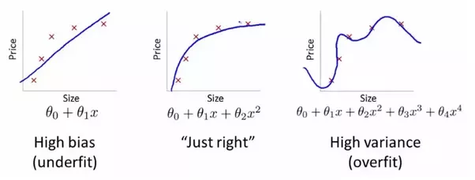
Bias and Variance - Reminder

Slide 3
Train / Valid set for training process
Loss
Epochs

Slide 4
Train / Valid set for training process
Loss
Train
Epochs

Slide 5
Train / Valid set for training process
Loss
Valid
Train
Epochs

Slide 6
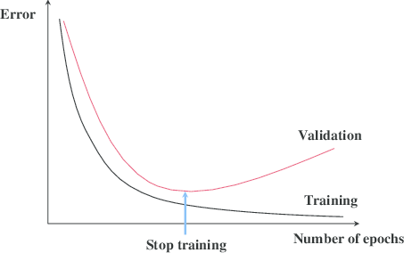
Early Stopping AlgorithM
Create 3 datasets (Train, Validation, Test)
Train your model on Train dataset for 1 epoch
Check the loss (cost, error) on Validation dataset
If the Validation loss decreases, continue training
When everything is done, test your model on your test dataset

Slide 7
Train / Validation / Test
The Test dataset should be used only in the very end of your training process
Every time you want to select and compare some hyperparameters (learning rate, number of neurons, number of layers etc) you should use the Train and Validation dataset
In classical Machine Learning the typical split among Train / Validation Test set is 60/20/20

Slide 8
Data Leakage
Data leakage causes a model to look accurate until you start making decisions with the model, and then the model becomes very inaccurate.
Data leakage occurs when your model can somehow ‘see’ the test dataset during the training process.
There are two main types of leakage: Leaky Predictors and a Leaky Validation Strategies.

Slide 9
Leaky Predictors
This occurs when your predictors include data that will not be available at the time you make predictions.
Imagine you want to predict who will get sick with pneumonia. The top few rows of your raw data might look like this:
Preventing leaky predictors:
To screen for possible leaky predictors, look for columns that are statistically correlated to your target.
If you build a model and find it extremely accurate, you likely have a leakage problem.
Got_pneumonia | Age | Weight | Male | Took_antibiotic | …
False | 65 | 50 | M | False | …
False | 72 | 68 | F | False | …
True | 58 | 62 | M | True | …

Slide 10
LEAKY VALIDATION STRATEGY
Occurs when you aren't careful distinguishing training data from testing data.
For example, this happens if you run preprocessing (like fitting the Imputer for missing values) before calling train_test_split.
Testing is meant to be a measure of how the model does on data it hasn't considered before.
You can corrupt this process in subtle ways if the test data affects the preprocessing behavoir.
Preventing Leaky Validation Strategies
Exclude the validation data from any type of fitting, including the fitting of preprocessing steps.
This is easier if you use scikit-learn Pipelines.

Slide 11
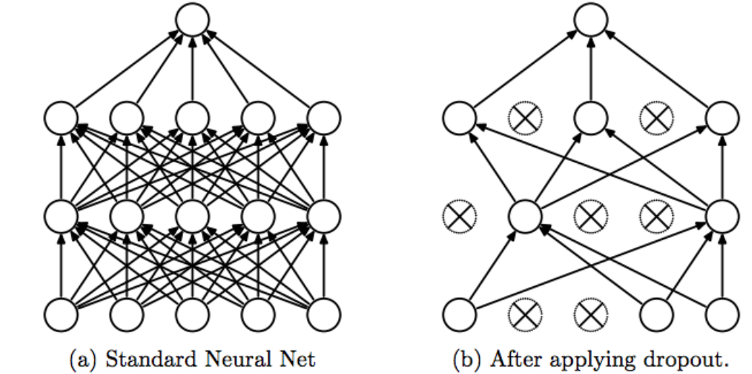
Dropout
Training Phase: For each hidden layer, for each training sample, for each iteration, ignore (zero out) a random fraction, p, of nodes (and corresponding activations).
Testing Phase: Use all activations
You must either reduce activation by a factor p during the testing phase, or increase them during training.

Slide 12
Training with Dropout – Visualization

Slide 13
Dropout - summary
Dropout forces a neural network to learn more robust features that are useful in conjunction with many different random subsets of the other neurons.
Dropout roughly doubles the number of iterations required to converge. However, training time for each epoch is less.
With H hidden units, each of which can be dropped, we have 2^{H} possible models. In testing phase, the entire network is considered.

Slide 14
Thank you Q & A

